Slide 1
Webix
An Introduction
Frank Zammetti

Slide 2
What’s On The Agenda
Who’s this guy?
“The Ego Slide”
What’s this Webix business?
What is it, what can it do, etc.
Getting started
What’s needed to work with Webix?
A simple example
“Fisher Price’s My First Webix App”
Getting to the meat of it
A more substantial and real example to sink our teeth into
The big wrap-up
Wherein we look back fondly on our brief time together

Slide 3

Frank Zammetti
Who’s this guy?
noun, A geek
Application architect for BNY Mellon
Professional developer for right around 25 years
Amateur code monkey for about 13 years on top of that
Author of 9 books for Apress with #10 in the works
F/OSS contributor, founder/leader of a few projects

Slide 4
What’s this Webix business?
Yet another Javascript library
Well, toolkit technically
UI components for building modern SPAs
Fast and Lightweight
Simple. Also, simple. Oh, and did I mention SIMPLE?!
Flexible and extensible
Notes:
Framework vs. library vs. toolkit
Integration with third-party libraries and popular frameworks

Slide 5
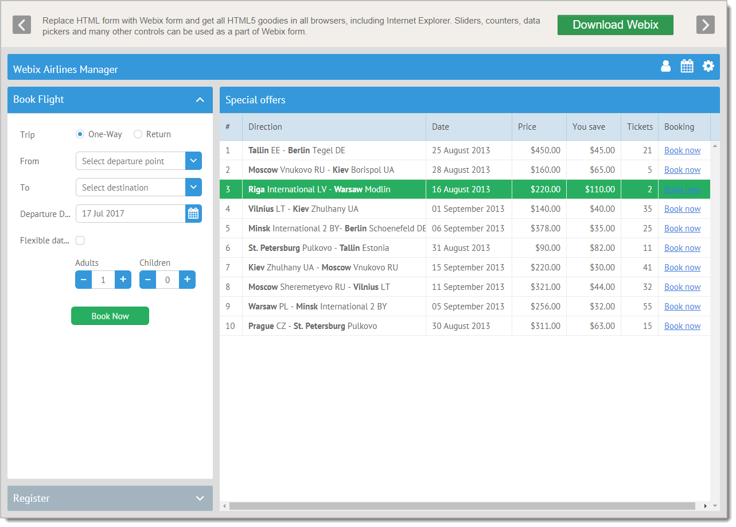
Example, Episode I
One of many examples from the Webix web site (webix.com)
Typical form controls
Powerful grids
Flexible layout capabilities

Slide 6
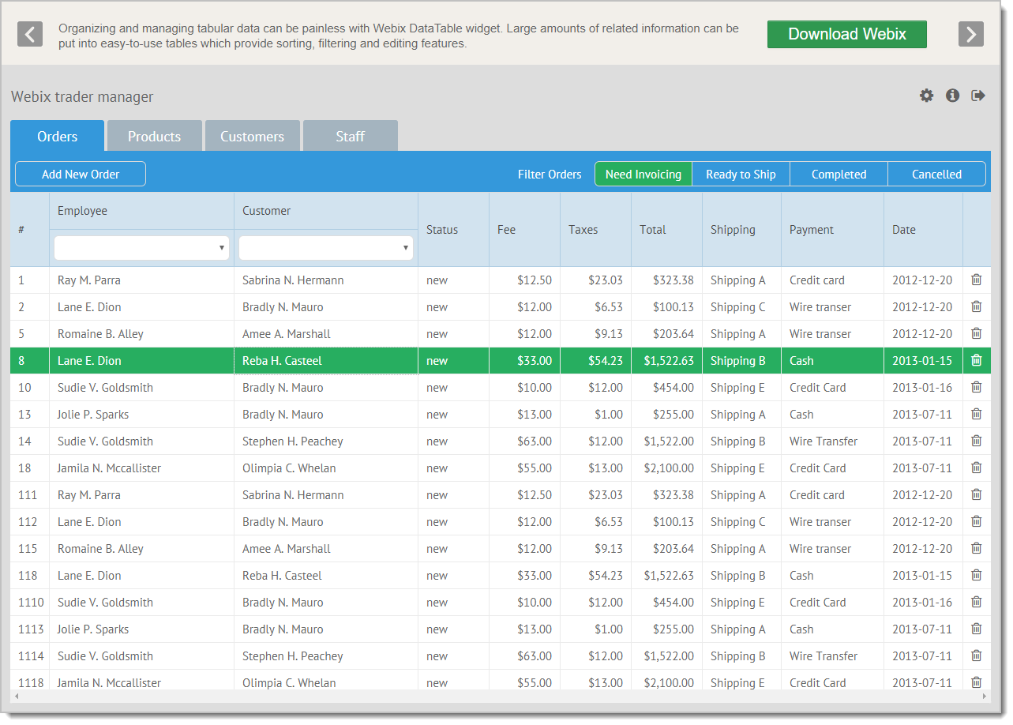
Example, Episode II
Here’s another more interesting example to feast you ocular units on
More advanced grid capabilities
Navigation controls
Skins

Slide 7
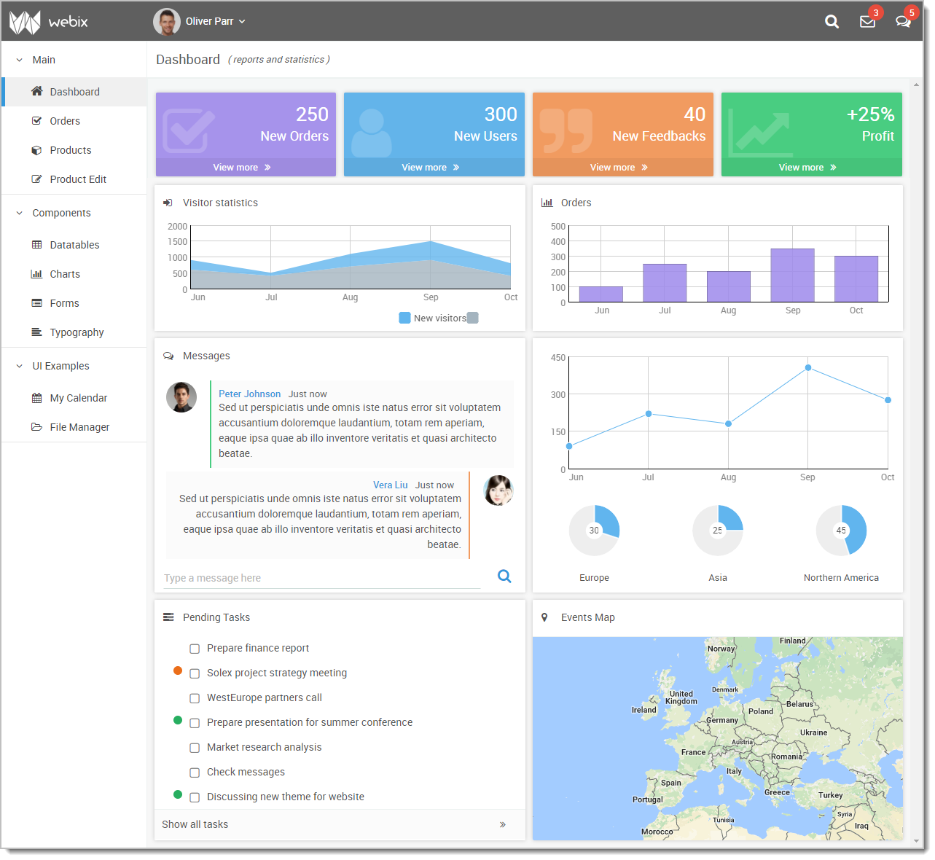
Example, Episode III
Even more advanced layouts are a piece of cake with Webix
Graphs and charts
Card-based layouts
Trees and other “advanced” data presentation widgets

Slide 8
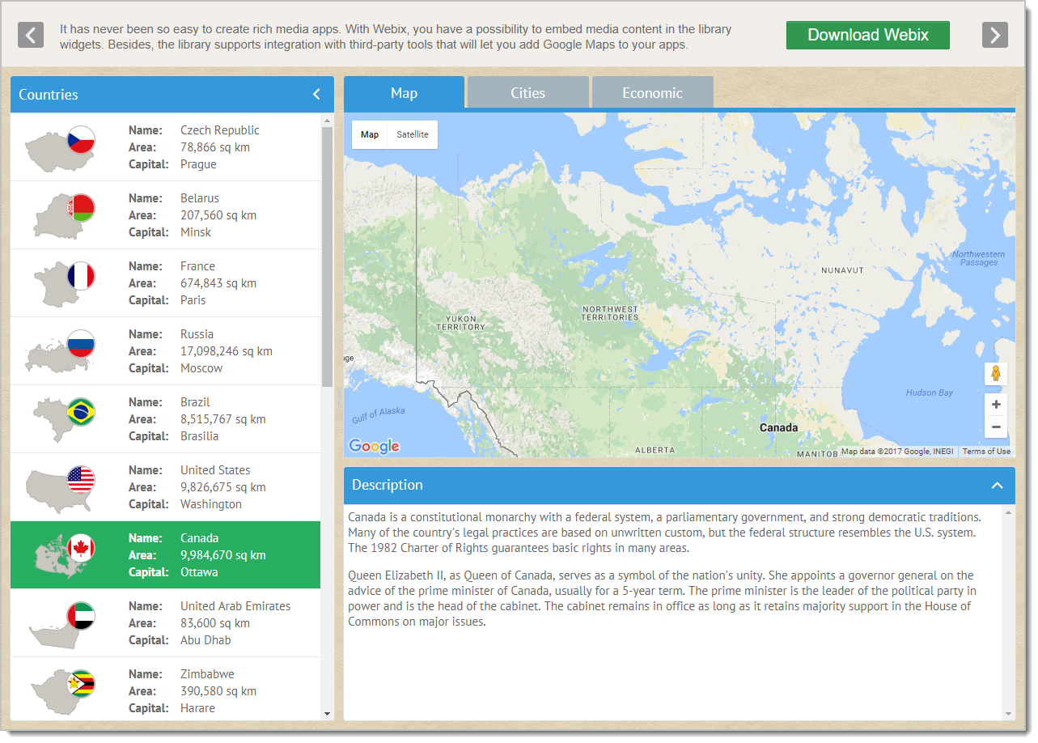
Example, Episode IV
Here’s one last example to, hopefully, sell you on what Webix has to offer
User-controllable interfaces
Responsive layouts
Integration with 3rd-party components/services
Notes:
https://webix.com/demos/web-desktop

Slide 9
History and such
Created by
XB Software, an IT outsourcing company from Minsk, Belarus
Initial public release
July 2013
Frequent updates
Generally sees updates every 2-3 months
Notes:
Fairly small company, a little over 150 employees
Updates are *fairly* good about backwards-compatibility

Slide 10
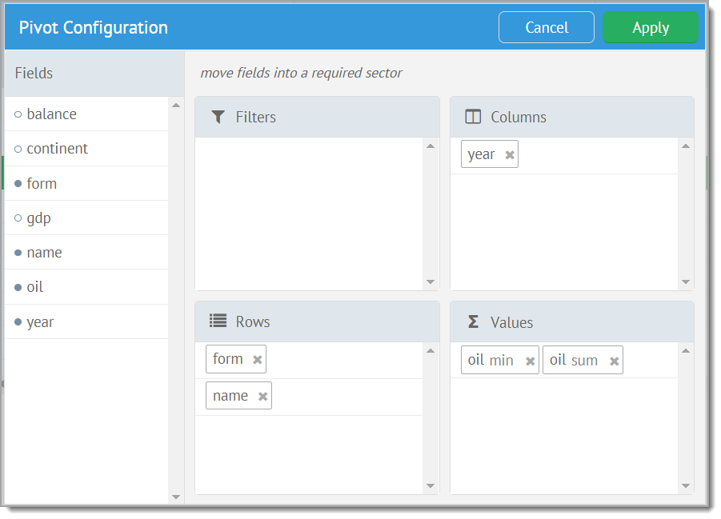
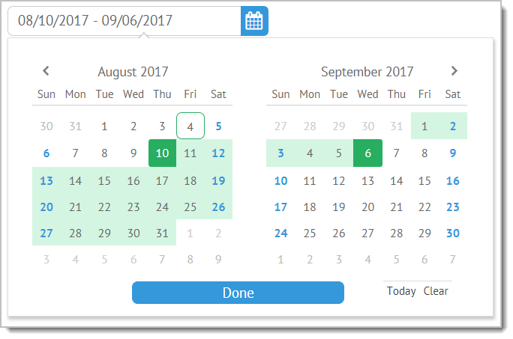

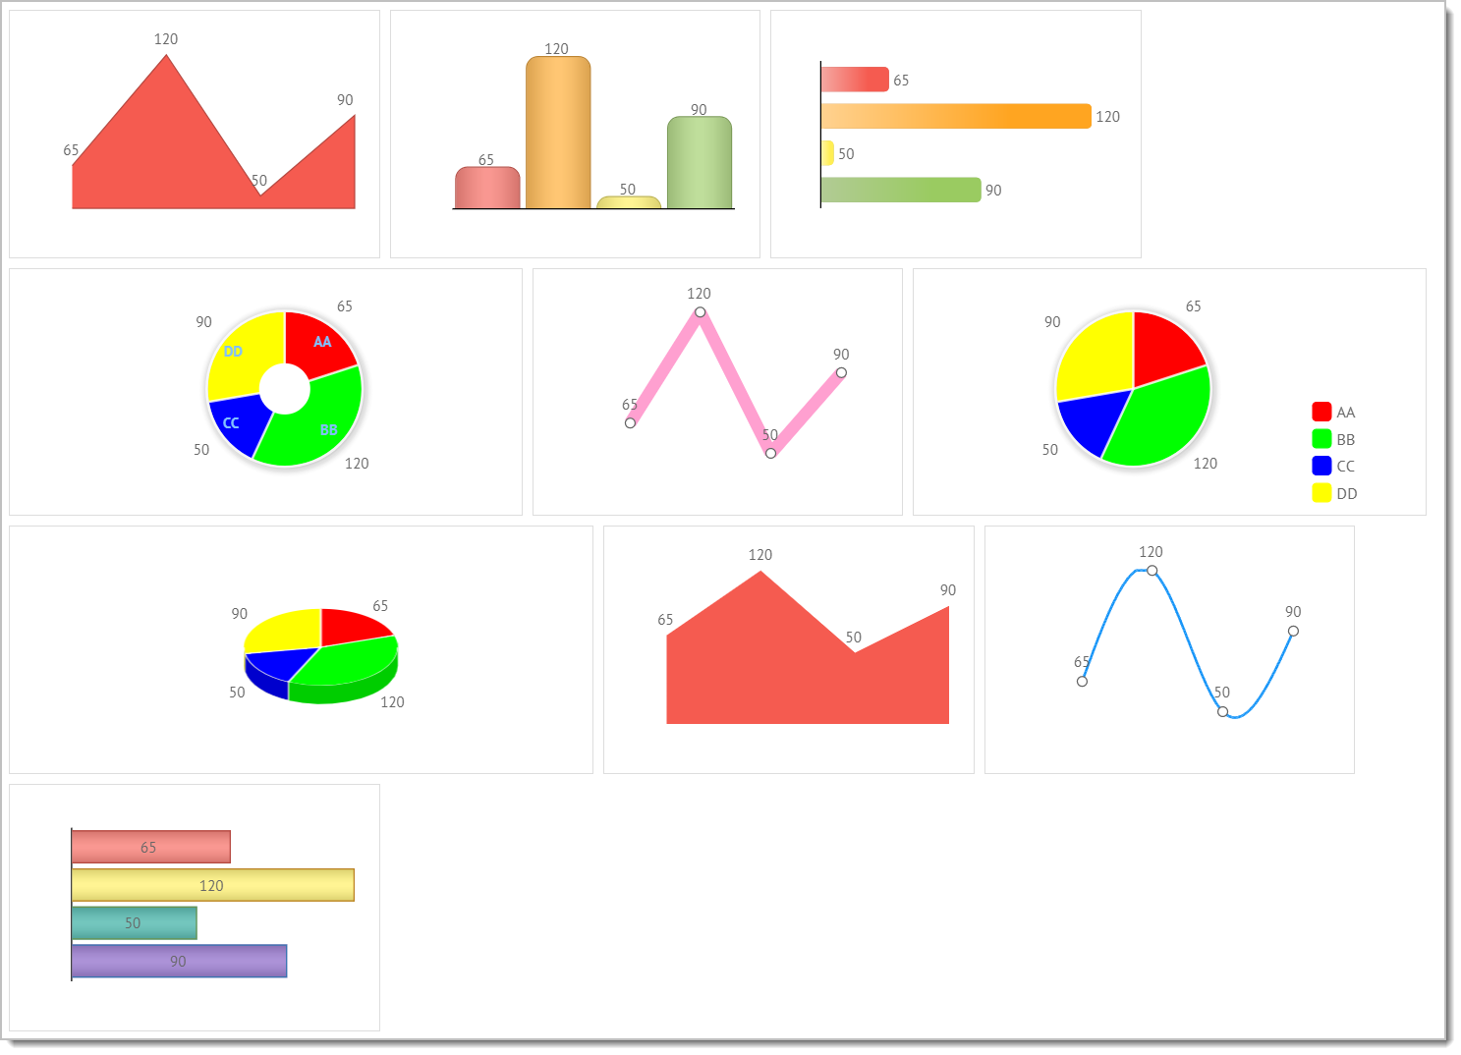
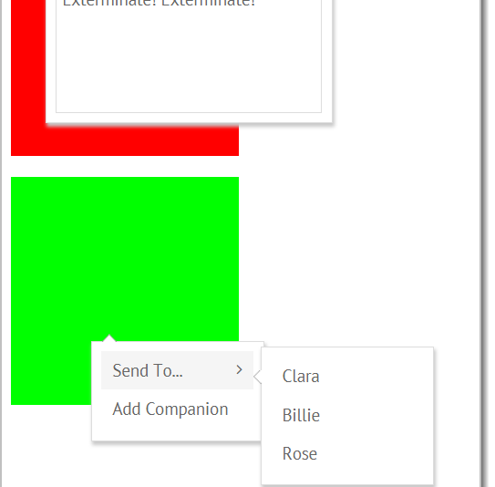
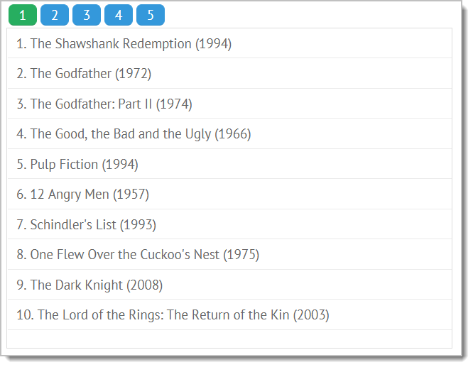
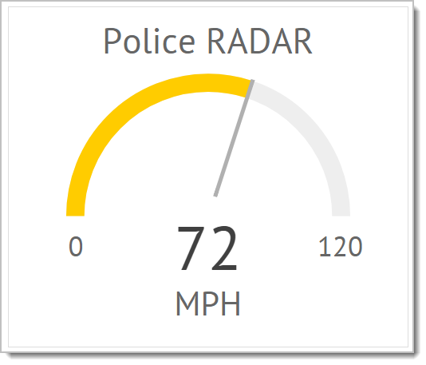
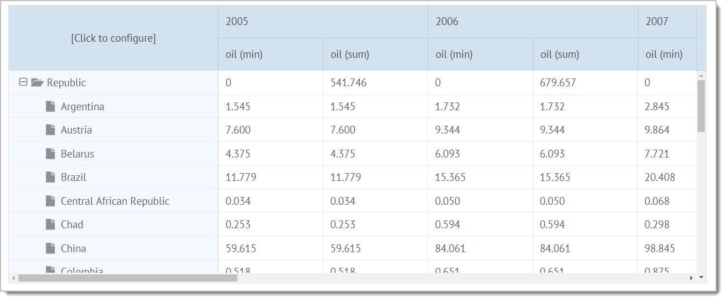
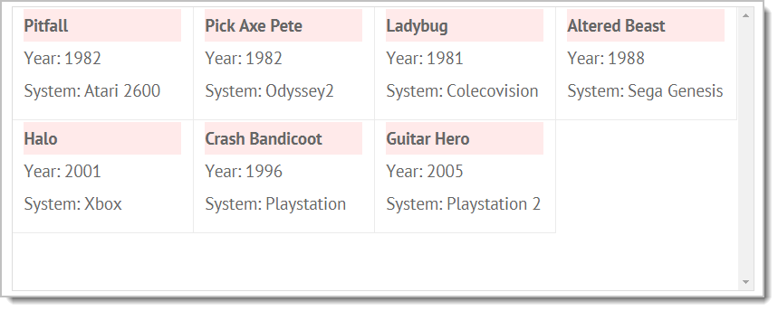
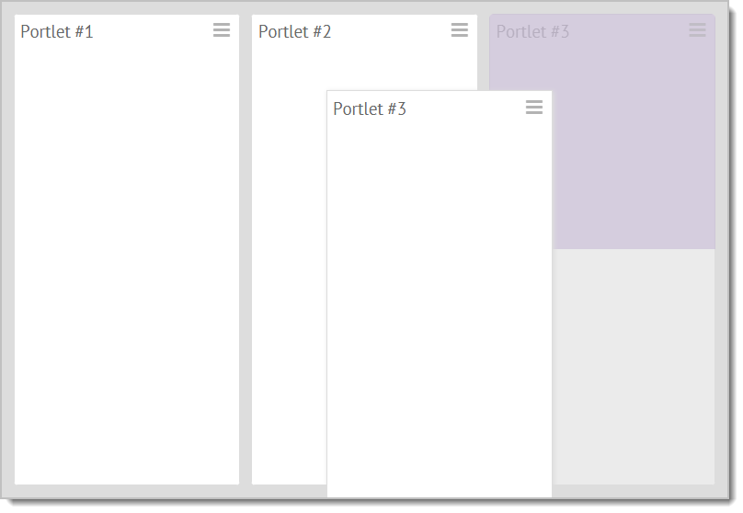
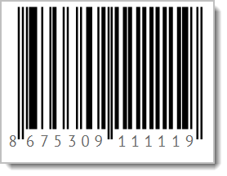
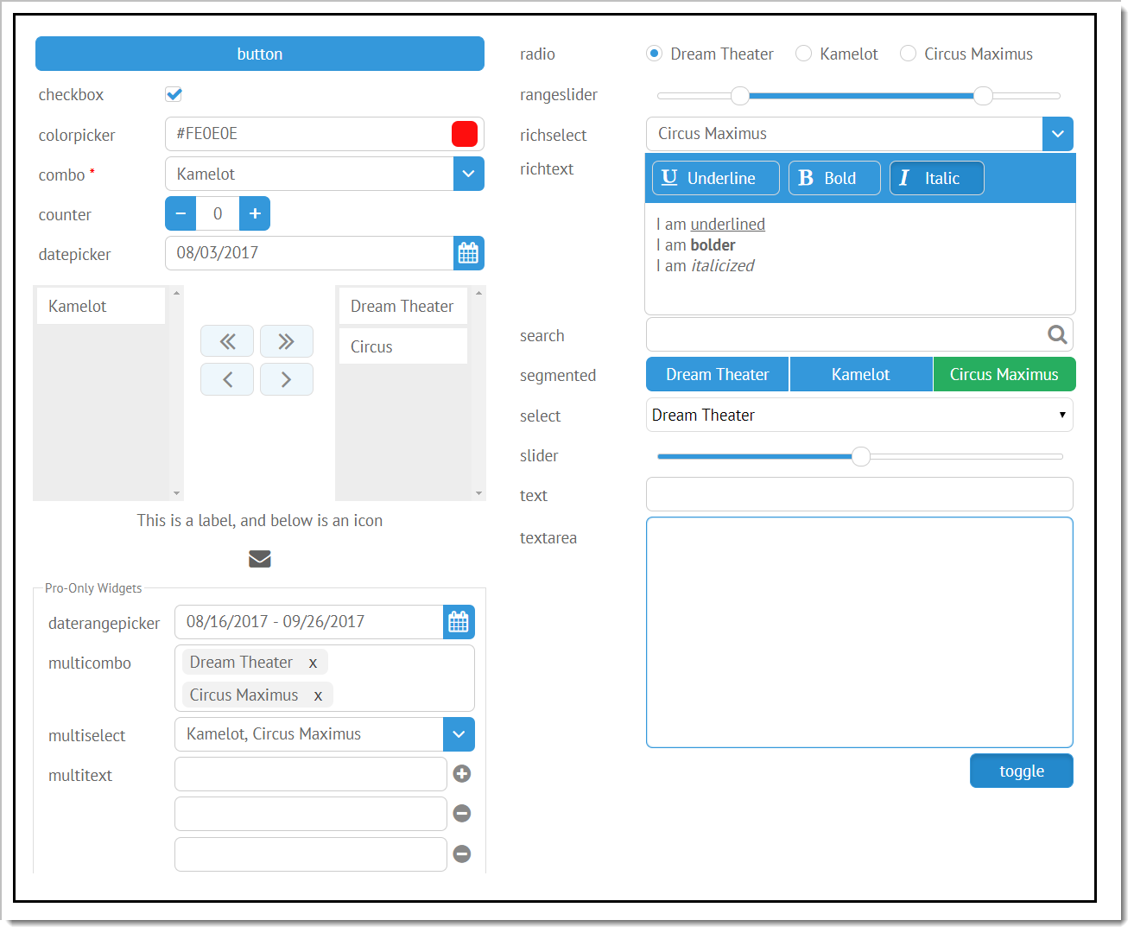
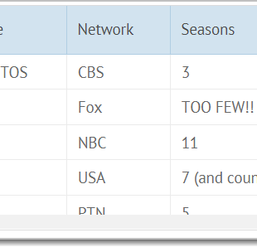
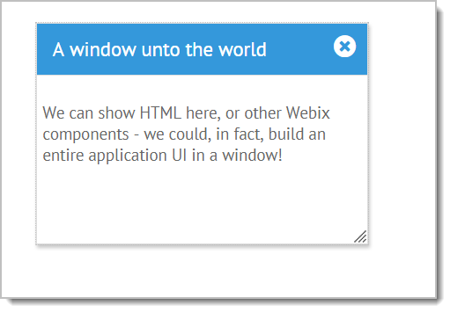
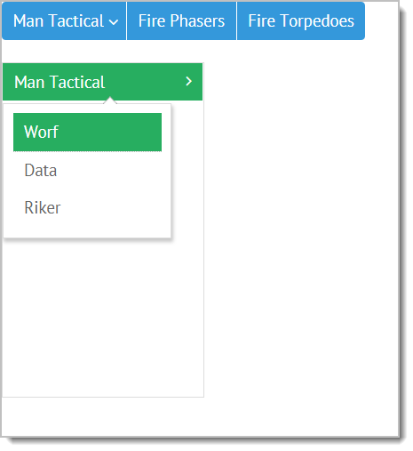
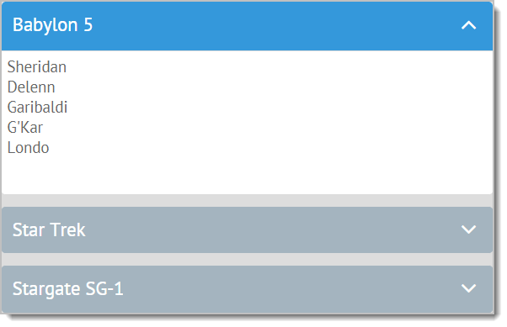
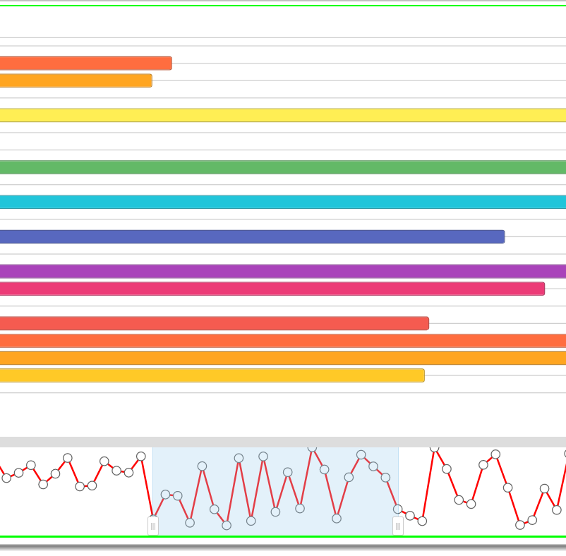
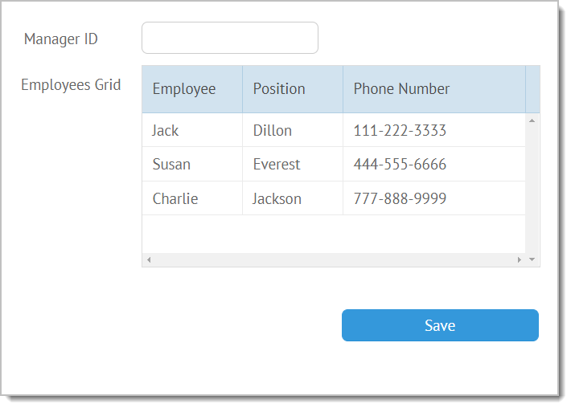
Lots of components
Widgets, specialized and complex widgets, controls
Notes:
Widgets = visual element to them
Specialized (“specific”) widgets = specialized in nature (bar codes, colorboard, etc)
Complex widgets = almost like full applications themselves (file manager, spreadsheet, etc.)
Controls = usually focused on user input or interaction

Slide 11
Components
Specific layout controls
Most common layouts: absolute, accordion, carousel, multiview, portlet, tabview, datalayout, toolbar
Form and data entry controls
button, checkbox, toggle, colorpicker, combo, fieldset, slider, textarea, richtext, etc.
Specialized data components
chart, datatable, dataview, list, tree, gage, bullet, organogram, rangechart, etc.

Slide 12
More components
Context components
contextmenu, popup, sidemenu, tooltip, window, etc.
HTML-oriented components
iframe, scrollview, template
“Specialized” widgets
calendar, colorboard, excelviewer, google-map, video, barcode, datarange, pdfviewer

Slide 13
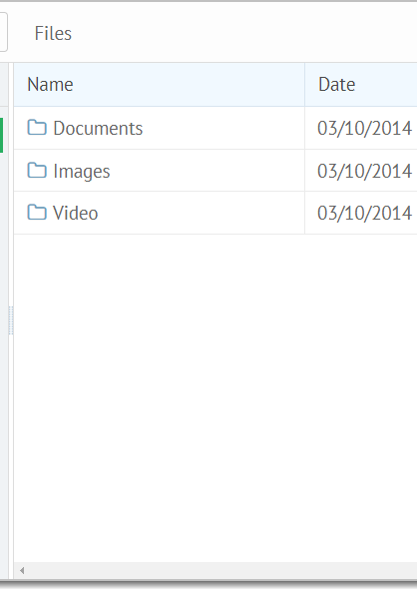
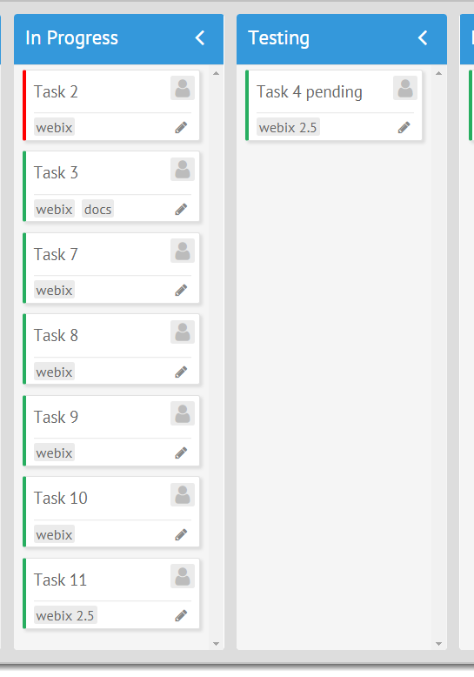
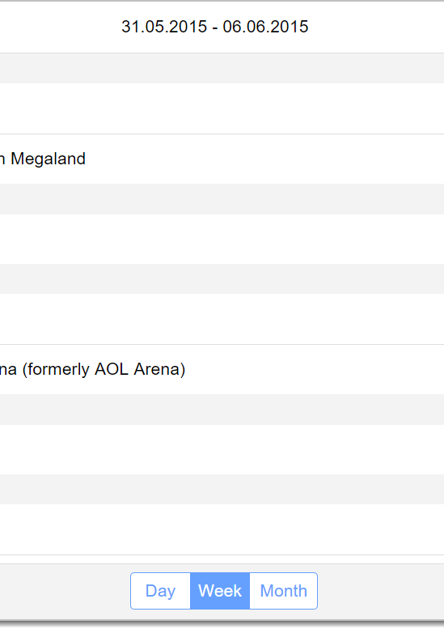
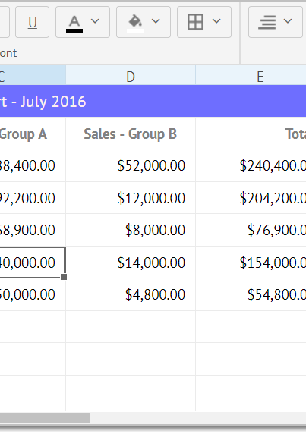
Premium Components
They’re like an entire app in component form!
filemanager
kanban
pivot
scheduler
spreadsheet
Purchased separately from Webix (depending on license)
Can be an app unto itself, or plugged into a larger Webix app
You may have to implement “backing” functionality yourself
Notes:
Show filemanager in “action”

Slide 14
Data handling
Robust data infrastructure
Inline with data attribute, or load from external source
Proxies
offline and cache, local, rest, indexdb (or custom)
DataStore
Where it winds up, lots of functionality, backs most data-aware components

Slide 15
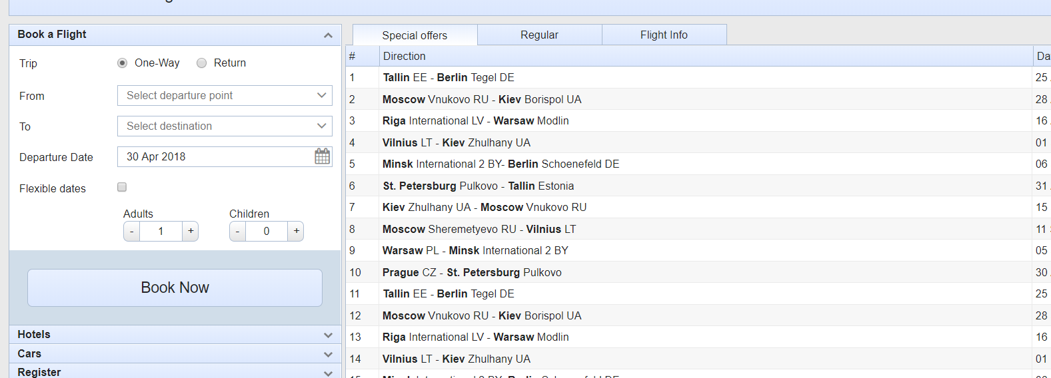
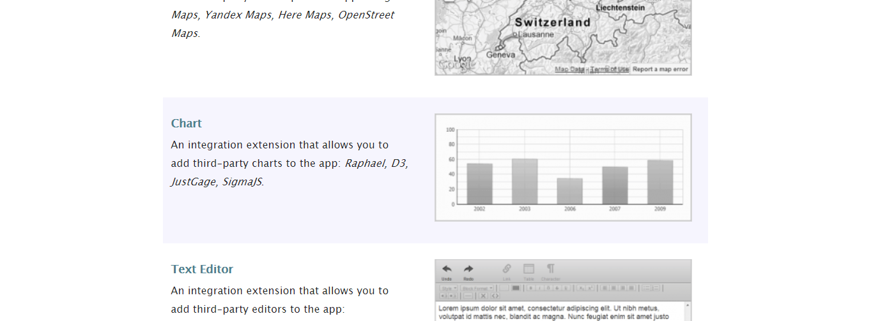
Webix can grow with your needs
Skins
Out of the box: Air, Air Compact, Clouds, Compact, Contrast, Flat, Glamour, Light, Material Design, Metro, Terrace, Touch, Web
Custom Font icon packs and code-based skin customization
Extensibility
Can subclass any existing component, or create from scratch, or use existing UI integration extensions
Integration with third-party libraries: Angular, Backbone, Firebase, JQuery, Meteor, React, TypeScript, Vue, DHTMLX
It’s not just a static, unchanging thing (unless you want it to be)

Slide 16
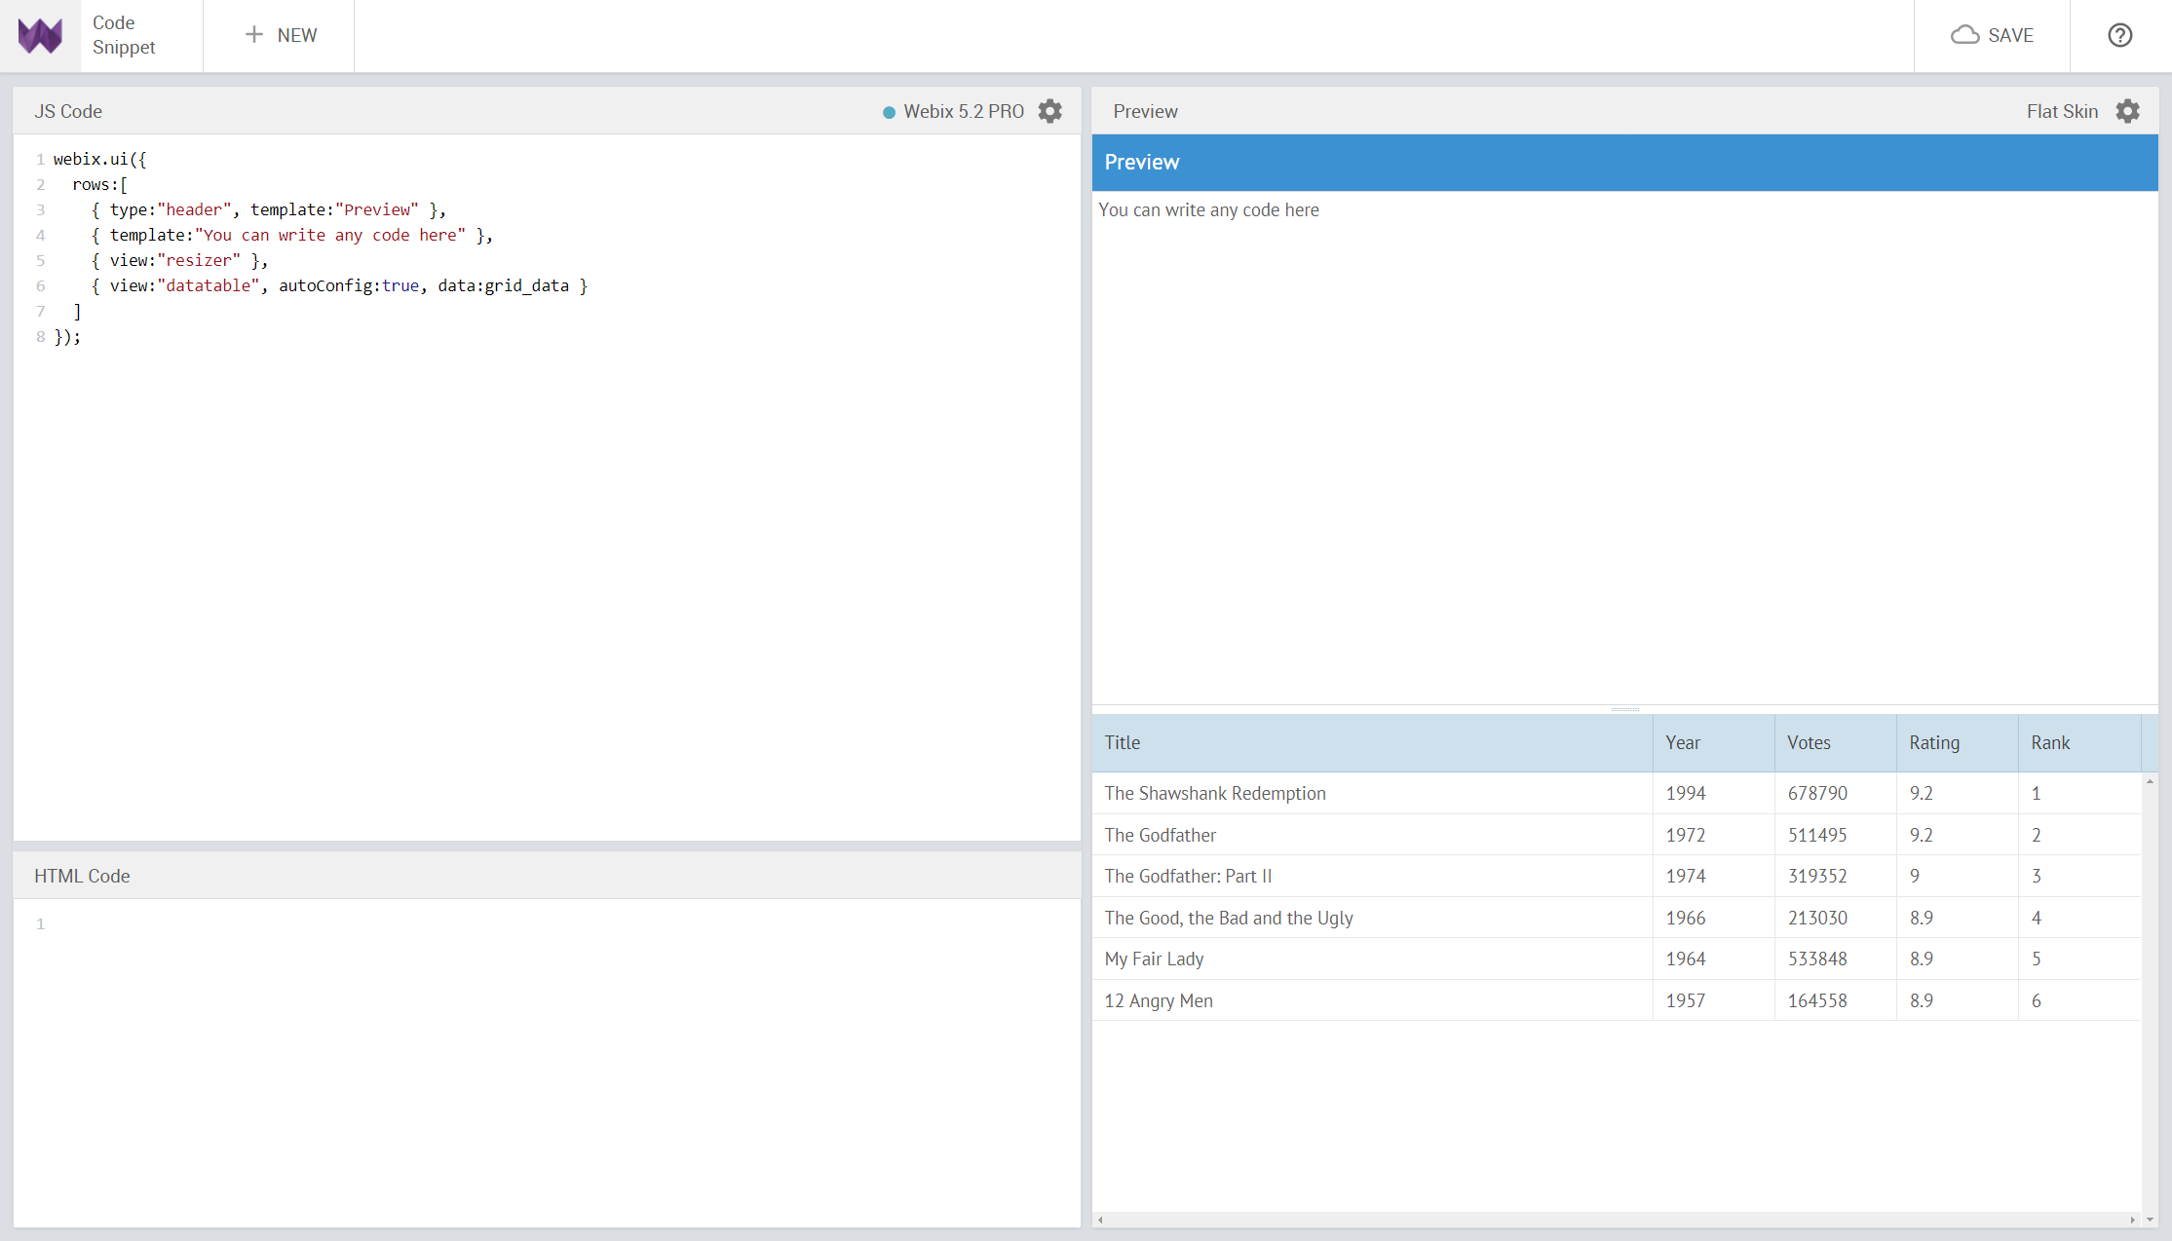
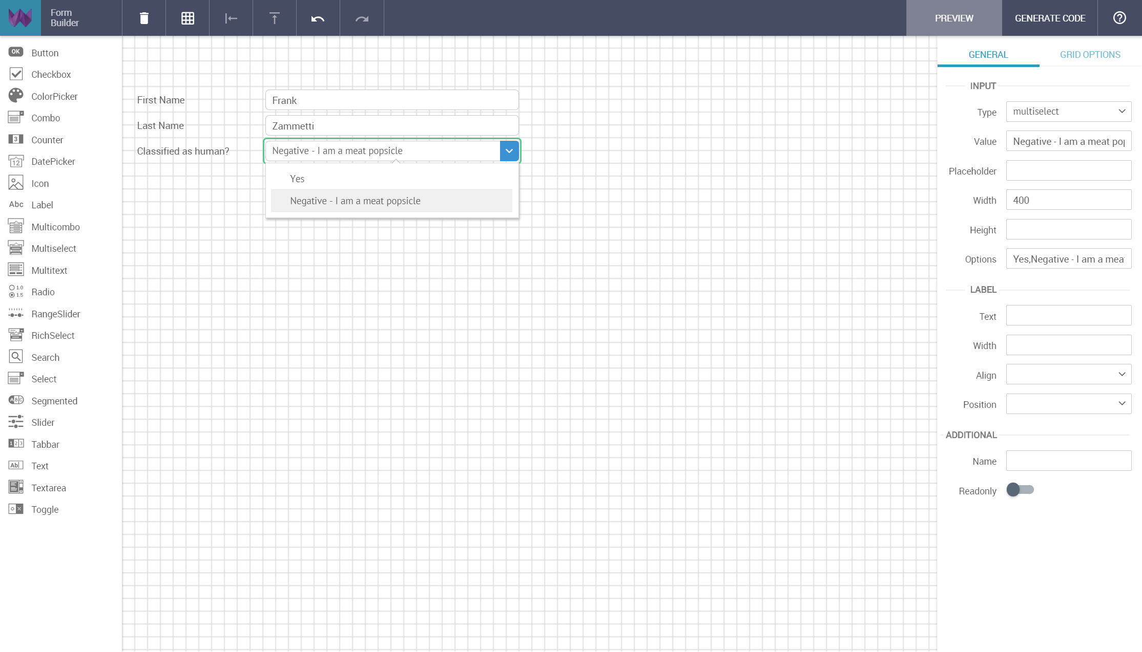
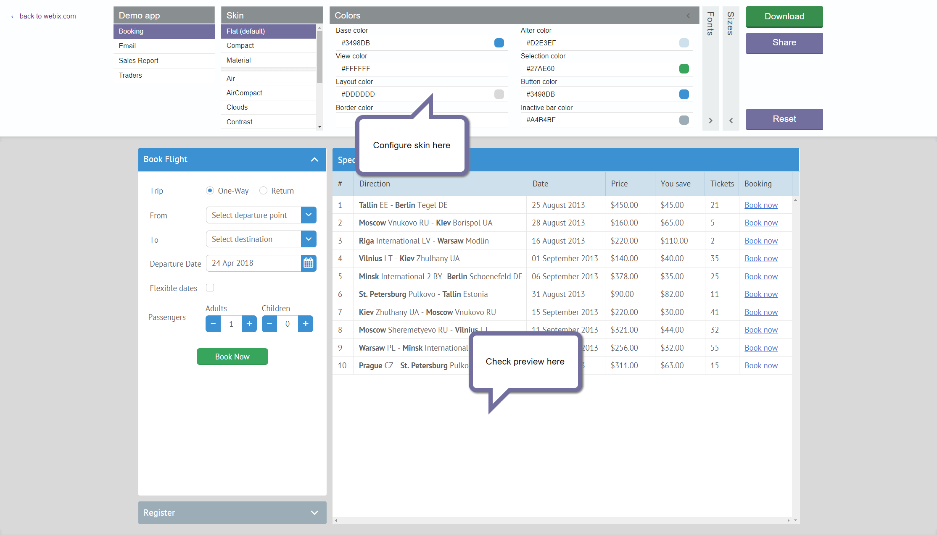
Online tools
Three tools offered right on the Webix web site
Code Snippet – A no-install way to play with bits of Webix code. Also allows easy sharing, especially handy for support tickets.
Form Builder – A GUI for designing forms and then generating the necessary code from it.
Skin Builder – A GUI for modifying skins and then generating the necessary stylesheet.
Notes:
https://webix.com/skin-builder/
https://snippet.webix.com/basic
https://webix.com/form-builder/

Slide 17




Not just about the visuals
Lots of general-purpose utility functions
Common and UI helpers: animate(), bind(), clone(), event(), extend(), isDate(), jsonp(), require(), stringify(), toArray(), toExcel(), wrap(), codebase, version
Ajax: bind(), del(), get(), getXHR(), headers(), patch(), post(), put(), response(), strinfigy(), sync(), timeout(), master
Env: cssPrefix, esModern, https, isAndroid, isEdge, isWebkit, mobile, printMargin, strict, svganimation, touch, transition, translate
Organized into a number of logical groupings in the Webix API (this is just a small sampling!)
HTML: addCss(), create(), getTextSize(), getValue(), locate(), offset(), pos(), remove(), removeStyle(), triggerEvent()

Slide 18





Licensing
All plans come with perpetual commercial license and one year of updates and support
GPL
$0 (but must abide by terms of GPL)
Individual License
$349
Company Pack
$2,499 (includes 5 complex widgets)
Devteam Pack
$3,999 (includes 5 complex widgets)
Unlim Pack
$9,499 (includes 5 complex widgets)
Individual: One developer, one project, basic support (72h IRT, 10 tickets)
Company: Unlimited developers, one project, standard support (48h IRT, 30 tickets/unlimited 1st month)
Devteam: 5 developers, unlimited projects, standard support
Unlim pack: Unlimited developers and projects, priority support (24h IRT, unlimited tickets, 10 live chat sessions, emergency bug fixes, integration audit)
Notes:
IRT = Initial Response Time

Slide 19




Why Webix?
Documentation
Mobile Support
Comprehensive
Tools
Robust and well-written. API docs (hyperlinked), how-to’s, guides, tips & tricks via blog, etc.
Webix Uis by default works fine on mobile: less duplicate/branch code with Webix
Forget the seemingly good polyglot approach, Webix has everything you need.
Critically, none are actually required! But, Webix does offer some handy online tools.
Notes:
API docs link to examples and extended details where appropriate
One of the few libraries I’ve seen that works equally well on mobile or desktop without doing anything specifically at all, but you still will have to do some work typically

Slide 20
Getting Started
The NPM way
npm init Add to package.json: “dependencies” : { “webix” : “*” } npm install
The “direct” way
Download archive, extract
Either way…
…what happens next is up to you!

Slide 21


1
A simple example
Notes:
First App
Show both forms

Slide 22
Structuring a Webix app
Not opinionated
Unlike some others, it’s up to you
I recommend
Separate out UI layout from actions
Webix Jet
Microframework if you want a bit more rigid structure

Slide 23
1
More code! MORE CODE!
Notes:
Second App

Slide 24
Getting to the meat of it: Webix Trivia!

Slide 25





The big wrap-up
github.com/fzammetti
linkedin.com/in/fzammetti
fzammetti
fzammetti@etherient.com
zammetti.com

